Slide 1

Technical Customer Services
CT2 – PPMo Tracking Function
www.conti.com.br

Slide 2
Technical Customer Services
CT2 – PPMo Tracking function
What is the Tracking Function
How to access and configurate it in CT2 website
How to download the PPMo Tracking report (RPT042)
How to set up the “Tracking Inspection” in Pocket Survey (mobile app)
How to perform an inspection with the “Tracking Inspection” function active

Slide 3
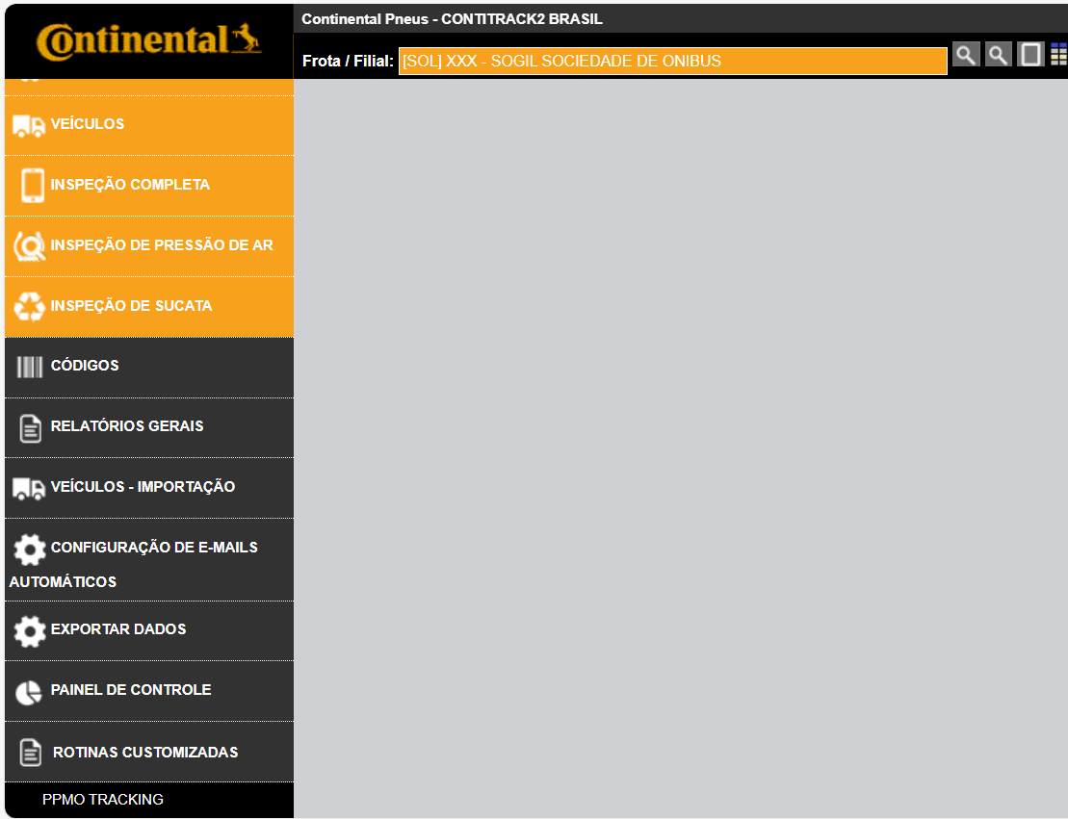
Technical Customer Services
CT2 – PPMo Tracking function
What is the Tracking Function?
  It is a function inside CT2 which allows a creation of predefined lists of products and fleets to be inspected in a structured way for future performance evaluation (report).
  Once the fleets/produtcs listed are inspected, the system uses some pre-defined criterias/rules to link inspections and bring back to a report the relevant data for performance analysis.
  PPMo tracking is located inside the “Custom Routines” in CT2 web platform.
Custom Routines
PPMo Tracking

Slide 4
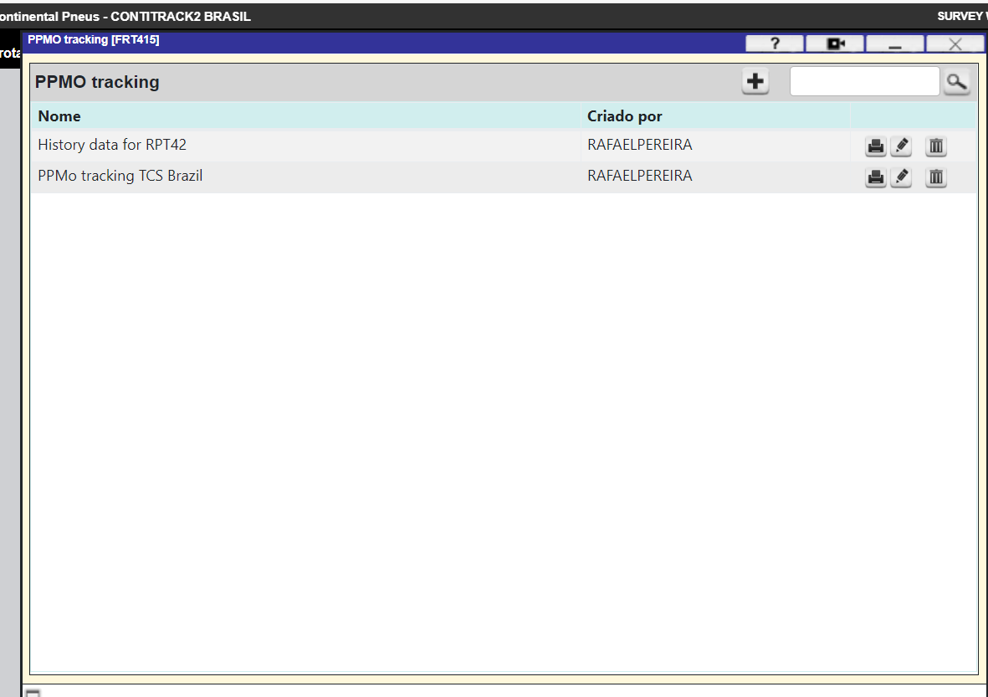
Technical Customer Services
CT2 – PPMo Tracking function
How to access and configurate it in CT2 website
  After selecting “PPMo Tracking” -> “Custom Routines” in CT2 web platform you are able to create a new list or update existing lists.
  By selecting “+” you can start a new “PPMo Tracking list” creation

Slide 5
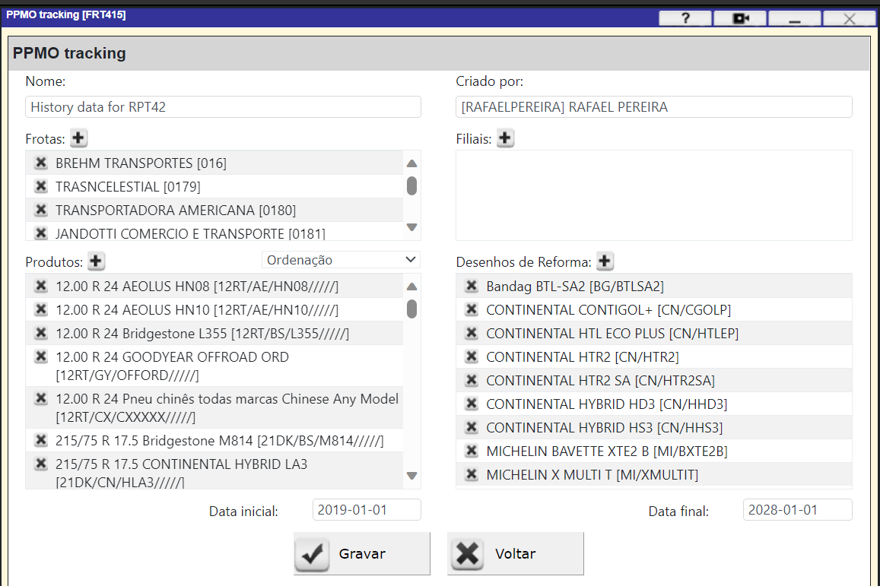
Technical Customer Services
CT2 – PPMo Tracking function
How to access and configurate it in CT2 website
  It is mandatory to include all the Fleets, Products (New tires or Retreads) that will be part of the Monitoring.
  Also a initial and final date should be included.
  All measured tires that comply with some pre-defined inspection criteria will have the data stored and will populate the “RPT042” report (basis for performance analysis and dashboard).
  Important: the “Tracking” function should be “flagged” in CT2 app (Pocket Survey) during the field inspections otherwise the PPMo report (RPT042) will not be created afterwards.

Slide 6
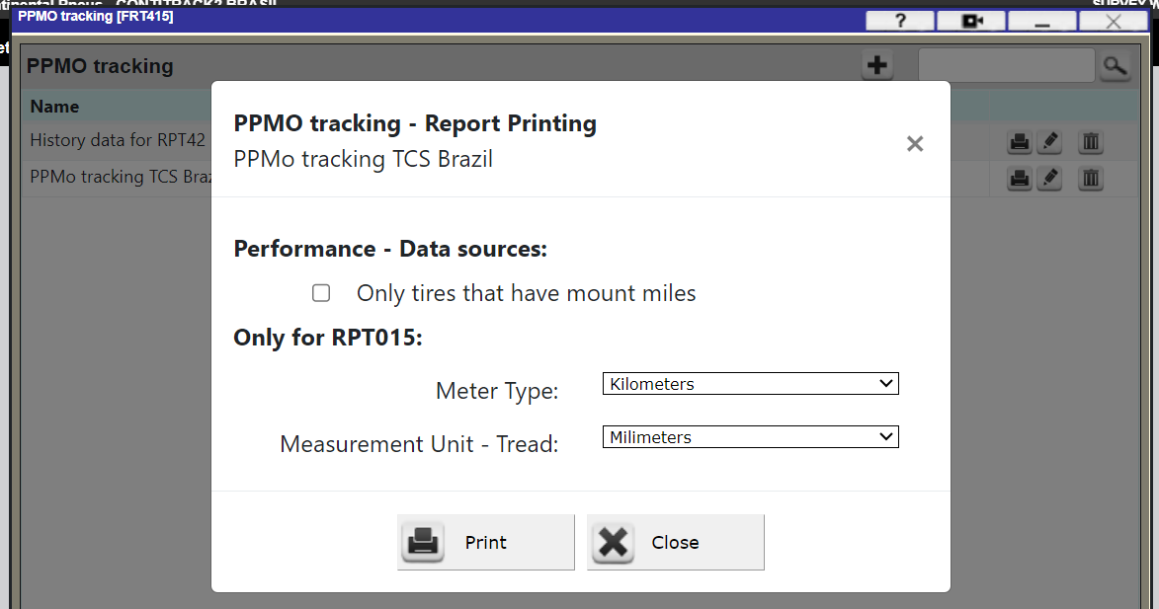
Technical Customer Services
CT2 – PPMo Tracking function
How to download the PPMo Tracking report (RPT042)
  Once the information (inspection) has been collected with the “PPMo Tracking” function on and the data is following the pre-defined criteria the RPT042 report can be downloaded by selecting the “print button”.

Slide 7
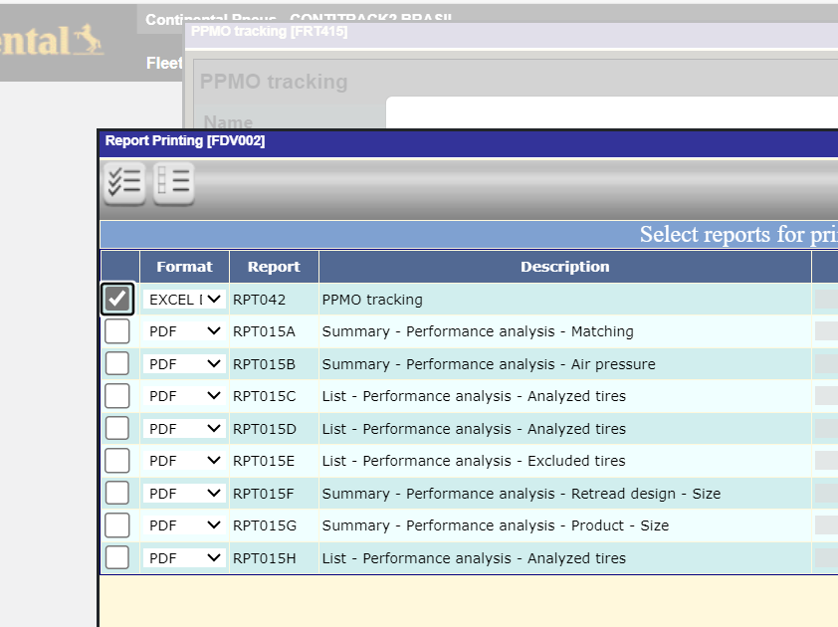
Technical Customer Services
CT2 – PPMo Tracking function
How to download the PPMo Tracking report (RPT042)
  Once the information (inspection) has been collected with the “PPMo Tracking” function on and the data is following the pre-defined criteria the RPT042 report can be downloaded by selecting the “print button”.
  Different types of reports can be downloaded, including the format RPT042 which is normally used for the “PPMo Performance” dashboard updates.

Slide 8
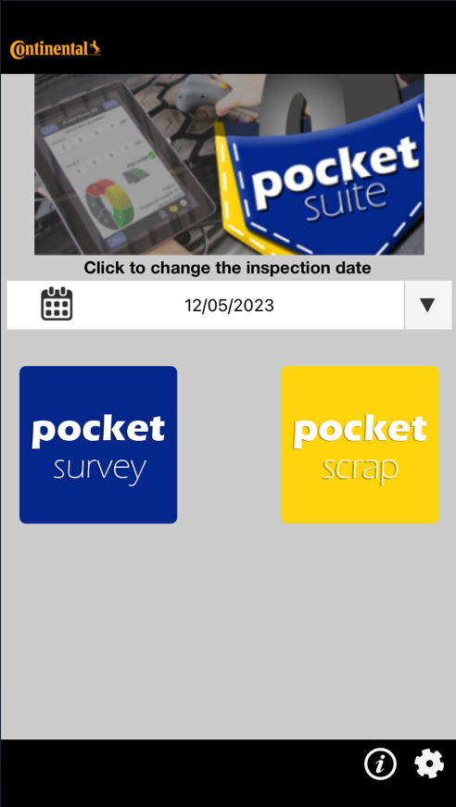
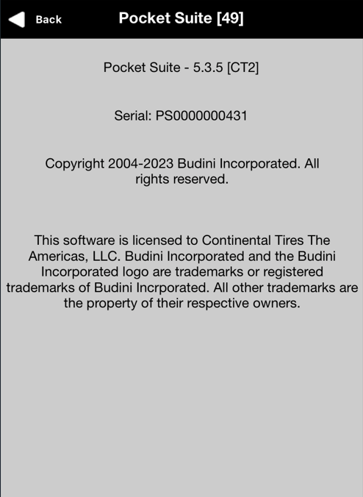
Technical Customer Services
CT2 – PPMo Tracking function
How to set it up in Pocket Survey (mobile app)
  The first step is to ensure that you are using the latest “Pocket Survey” APP version.
  Select the “Info” button in the bottom right of the Pocket Survey app screen.
  The version should be 5.3.5 [CT2] or newer.
  If you have a previous version installed, please make sure to update it before trying to configurate the “Tracking Function”.

Slide 9
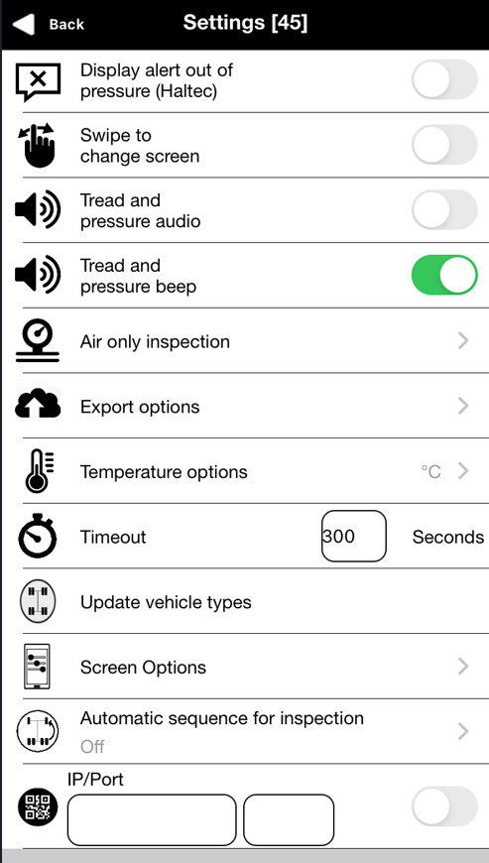
Technical Customer Services
CT2 – PPMo Tracking function
How to set it up in Pocket Survey (mobile app)
  Once app version is the latest one (5.3.5 or newer), please select the “configuration” button in the bottom right of the Pocket Survey app screen.
  Then select “Screen Options”
  A password will be requested, please, use: pssupport

Slide 10
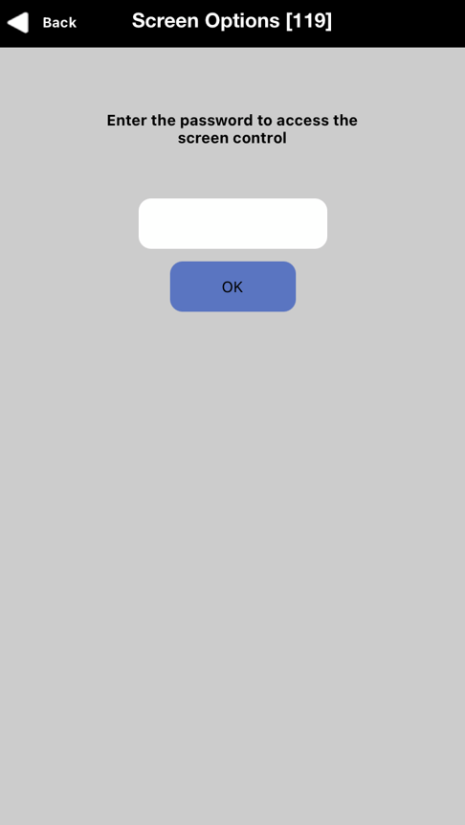
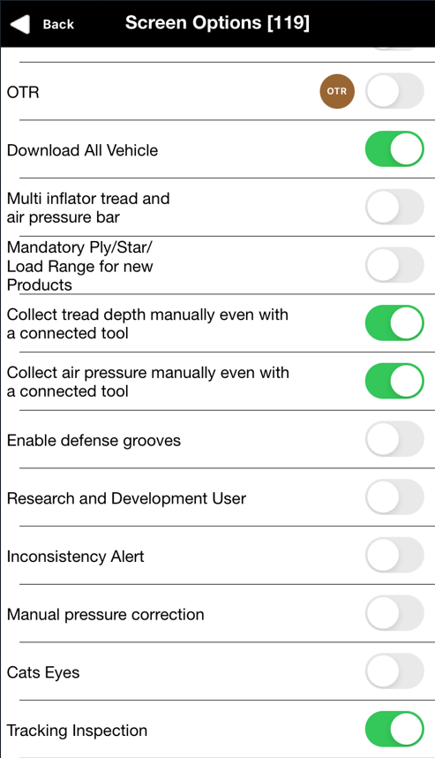
Technical Customer Services
CT2 – PPMo Tracking function
How to set it up in Pocket Survey (mobile app)
  A password will be requested, please, use: “pssupport”
  Enable “Tracking Inspection”
  After activating it a new checkbox should be available on the “Complete Inspection” screen on Pocket Suite App.
Password:
pssupport

Slide 11
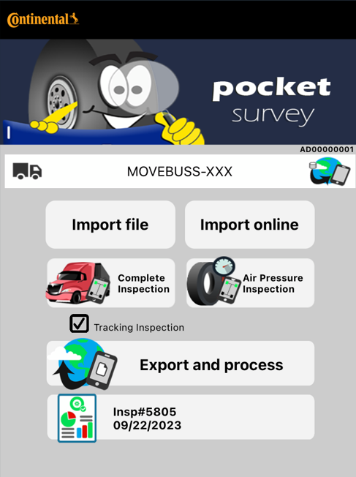
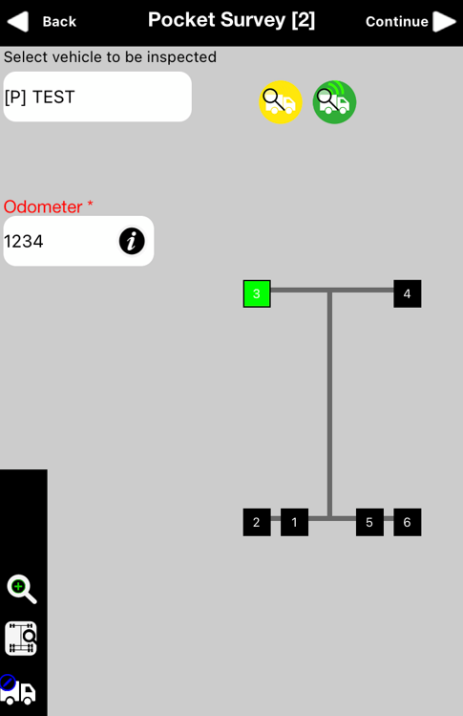
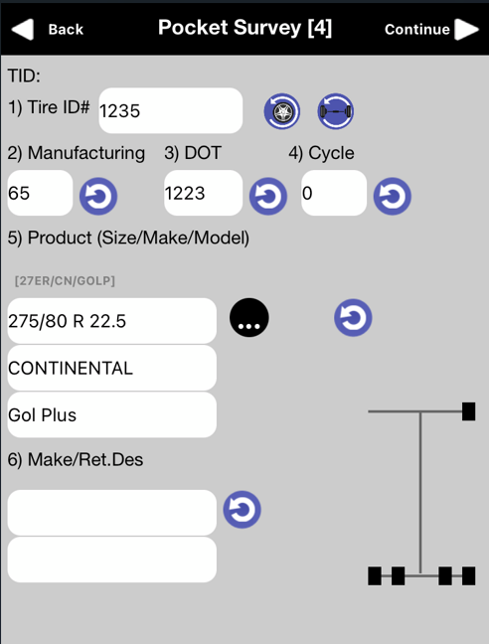
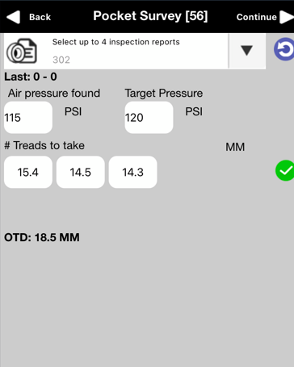
Technical Customer Services
CT2 – PPMo Tracking function
How to perform an inspection with the active function
  Always Make sure that the checkbox “Tracking Inspection” is selected before start the tire inspection.
  Collect all mandatory information such as: Odometer, DOT, Tire Size and Pattern, Inflation pressure, Tire condition, Tread depths.

Slide 12
Thank you
for your attention!

